Slide 1
Test Case Study
Kelly Yu

Slide 2
BAT Test Feature
System
Broadband
Home Networking
NAT
Firewall
MAC Filter
Parental Control
Remote Management
TR-069 Client

Slide 3
APIs Used for BAT Case
ACTS_3_0/api/Misc
Setup_Power_Switch
Enable_Network_Interface
Setup_xDSL_Line, Enable_xDSL_Line
Enable_NIC
Access WebGUI from WAN side PC
Get_Network_VLAN_ID
Get VLAN ID for WAN test case
NcFTP
Using FTP put/get file

Slide 4
APIs Used for BAT Case
ACTS_3_0/api
Get System Time (Misc)
Get_System_Date
Get_System_Time
Time_Diff
Service Check
Check_WKS_Ping (Console)
Start_WKS_iPerf3_Server (Console), Stop_WKS_iPerf3_Server (Console)
Start_WKS_Tshark (Console), Capture_Count_Chk (Misc)

Slide 5
APIs Used for BAT Case
Tools/module
Get_Interface_IP (Device_Console)
Interface could be br0 or WAN interface
Get_Image_Seq_Number (Device_Console)
Using for firmware upgrade case
Setup_TR069 (Device_TR69)
Using for TR-069 connection
Check_CPE_Event_Code (Device_TR69)

Slide 6
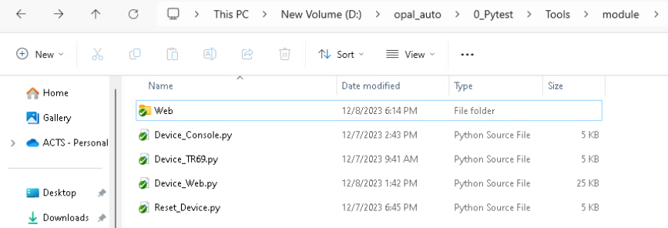
APIs for Device Configuring
Tools/module
Device_Console
Device_TR69
Device_Web

Slide 7
APIs for Device Configuring
Web
Setup Time setting
Setup LAN setting
Setup WAN setting
Setup Remote MGMT setting
Setup Port Forwarding setting
etc.

Slide 8
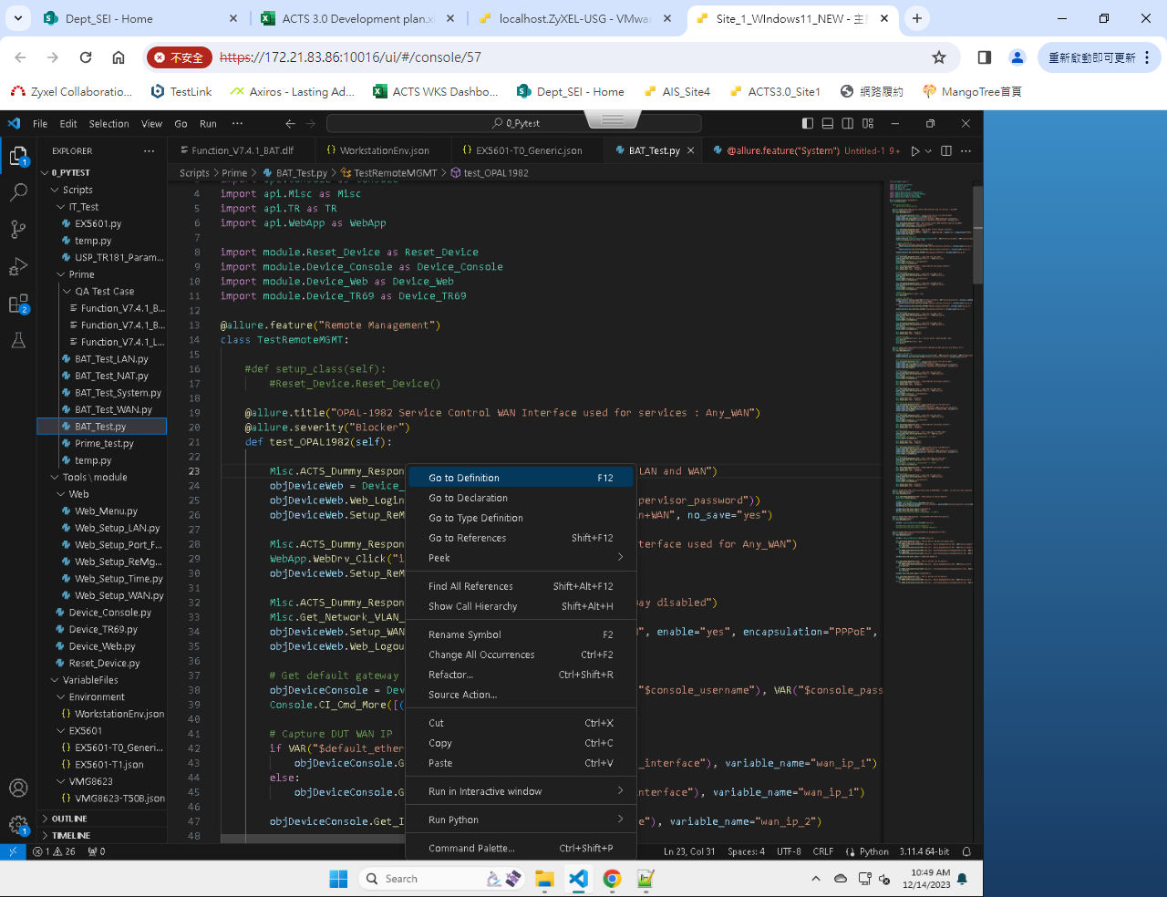
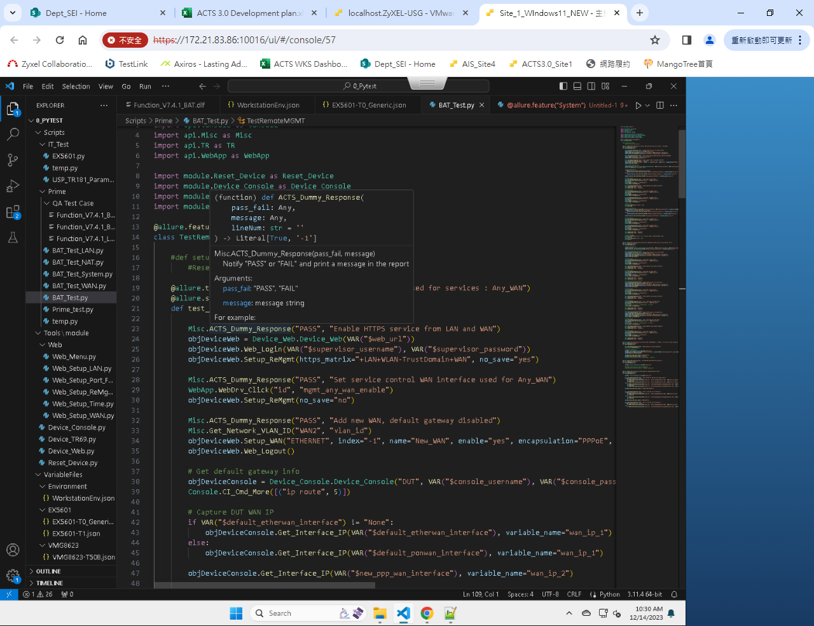
APIs Method – How to use xxx API

Slide 9
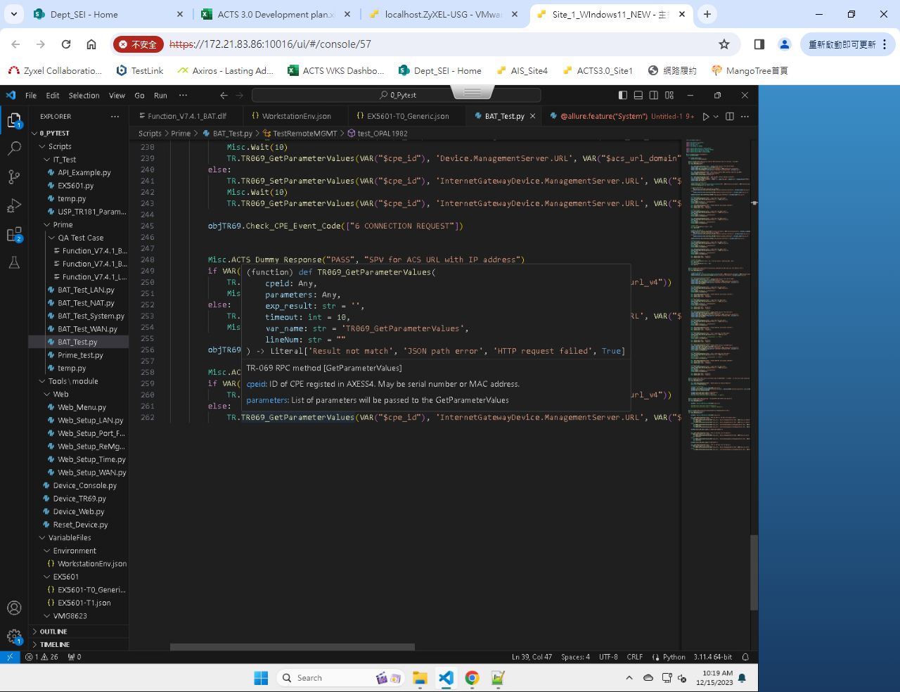
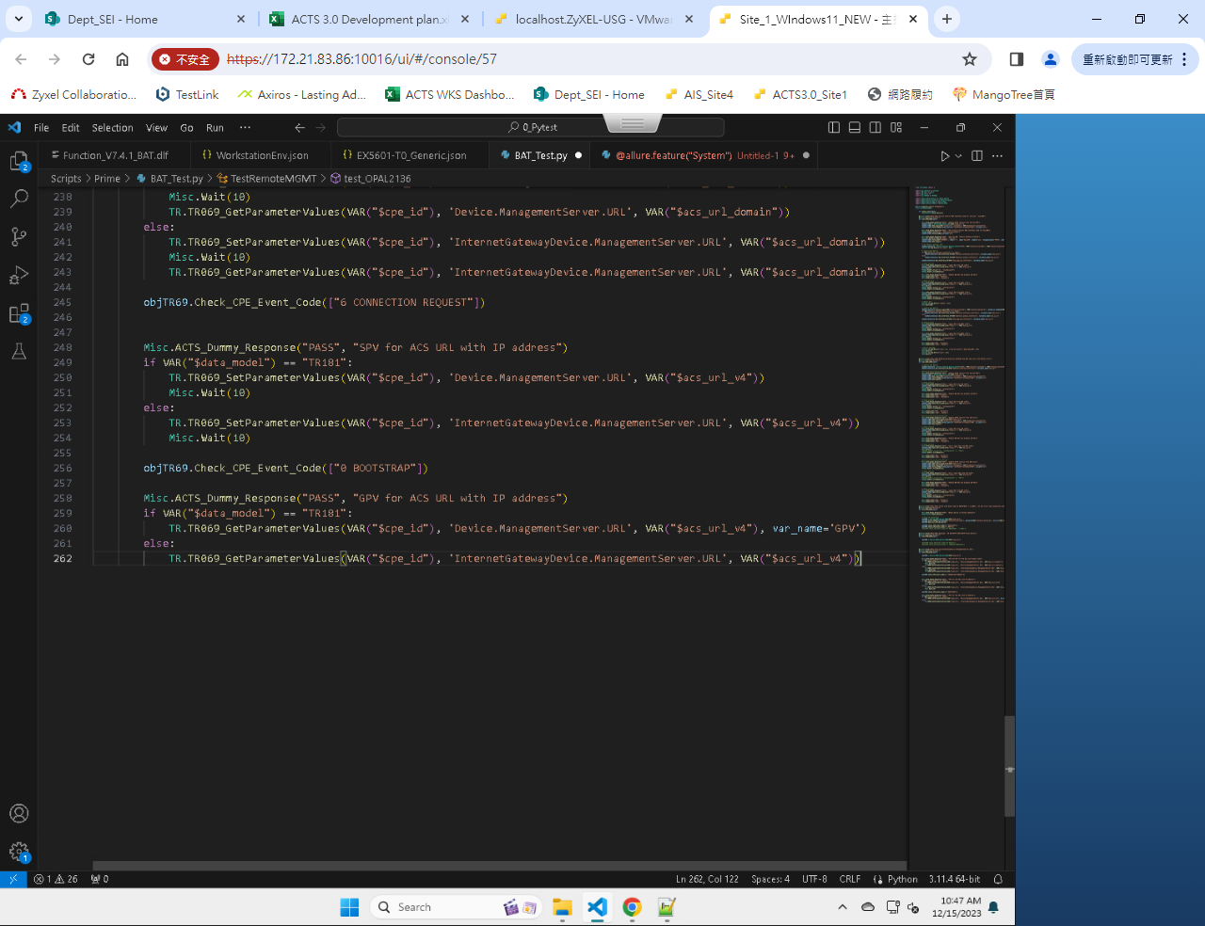
APIs Method – How to use xxx API
必填參數: cpeid, parameters
使用時必須依照順序填寫
選填參數: exp_result, timeout, var_name
不一定要依序填寫, 如果要跳著使用, 必須將參數名稱帶入
Example:

Slide 10
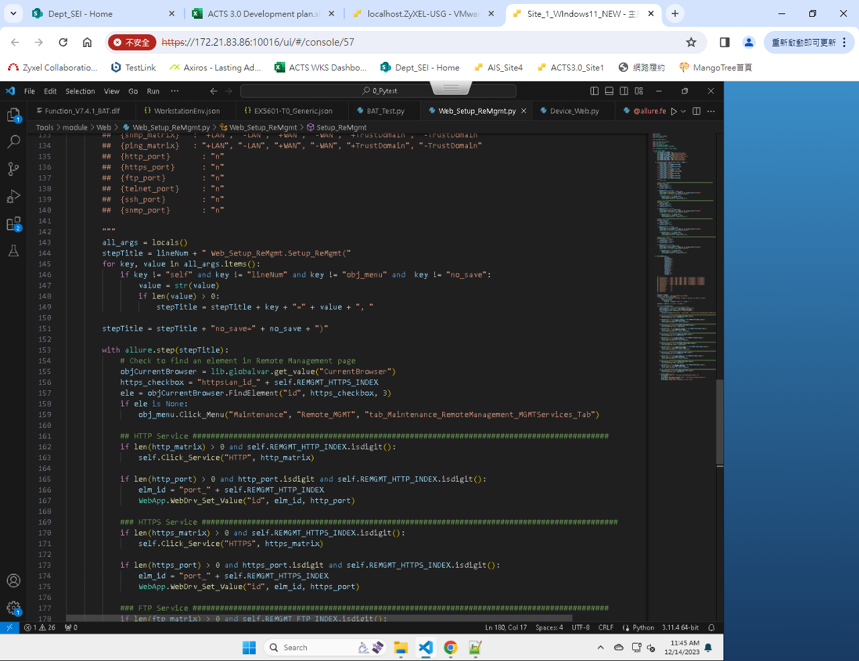
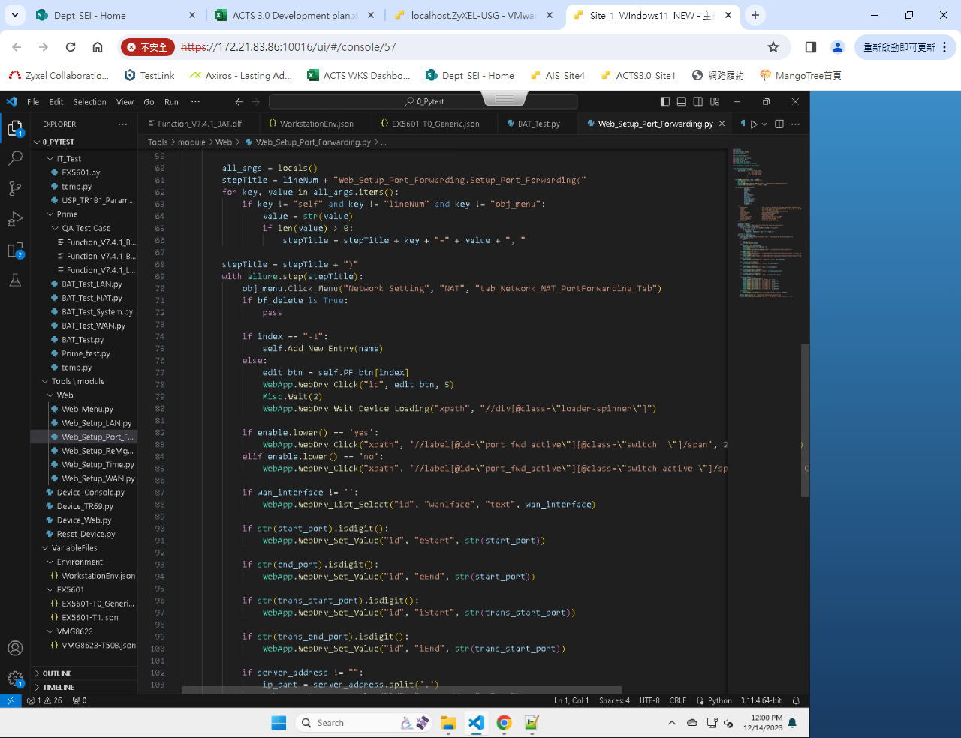
About Click_Menu
Click_Menu 不會單獨使用，所有的 Web function module 都應包含 Click_Menu 動作
Web_Setup_ReMgmt
Web_Setup_Port_Forwarding

Slide 11
Test Case 1 – Remote MGMT
Service Control WAN Interface used for services: Any_WAN
Setup Remote MGMT setting:
Configure “Service Control WAN Interface” as Any_WAN
Enable HTTPS service from LAN and WAN
Create new WAN interface
Service check: Login GUI from LAN and WAN side with Any_WAN

Slide 12
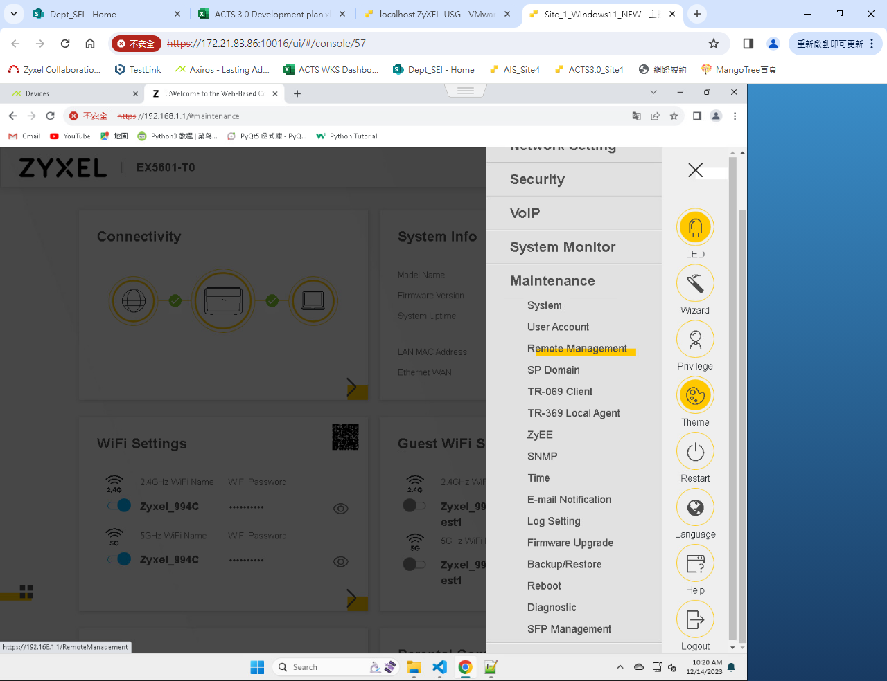
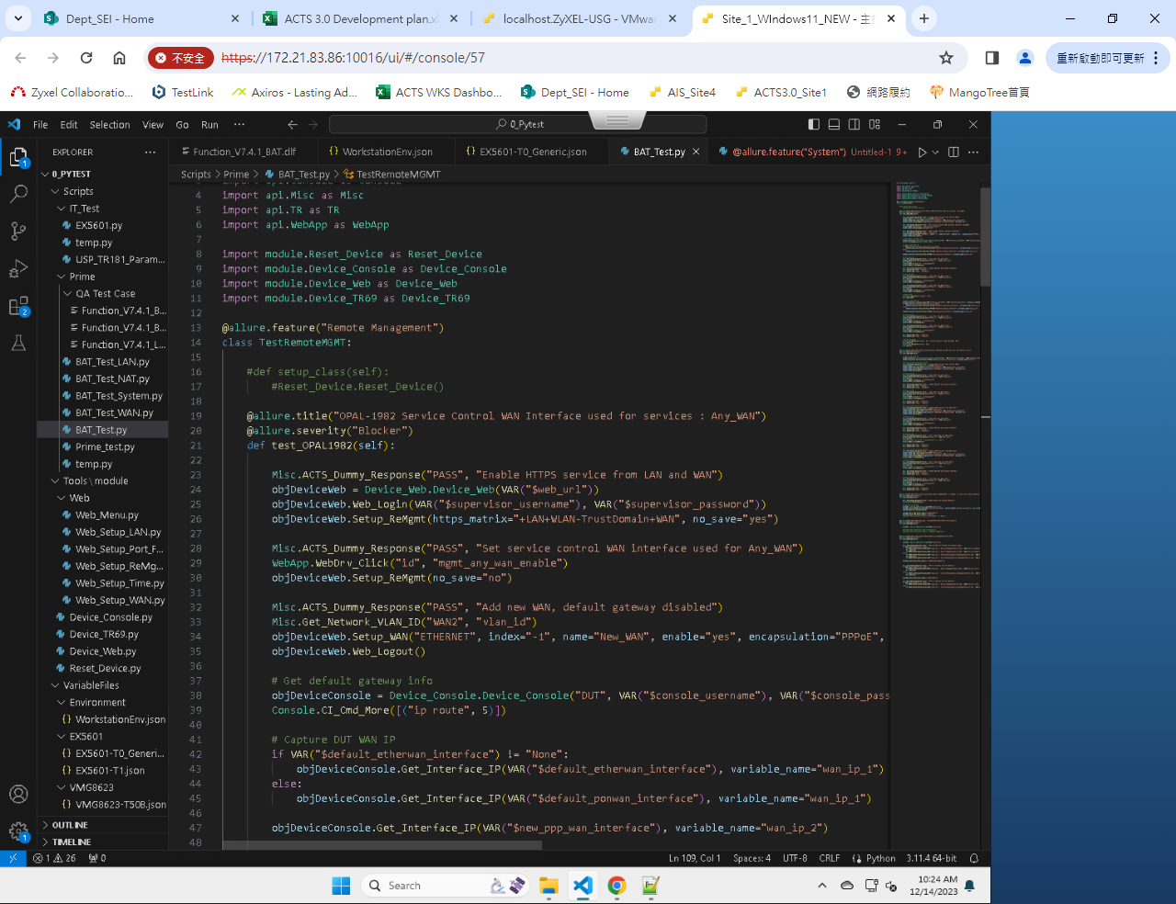
Test Case 1 – Remote MGMT
Click_Menu 的動作已被包在 Setup_ReMgmt function module 裡面

Slide 13
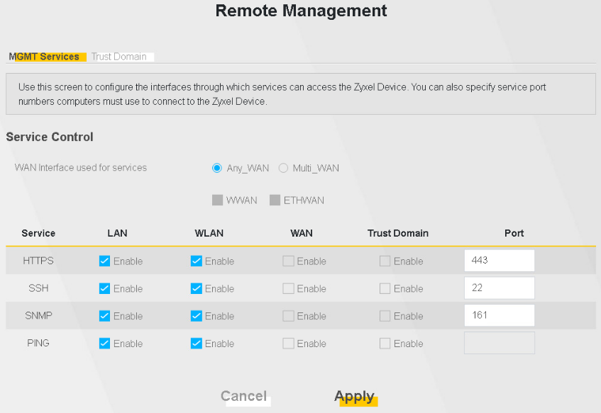
Test Step: Setup Remote MGMT setting

Slide 14
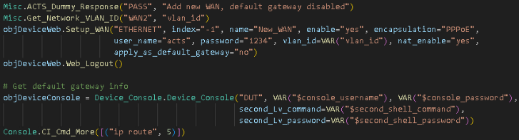
Test Step: Add new WAN interface

Slide 15
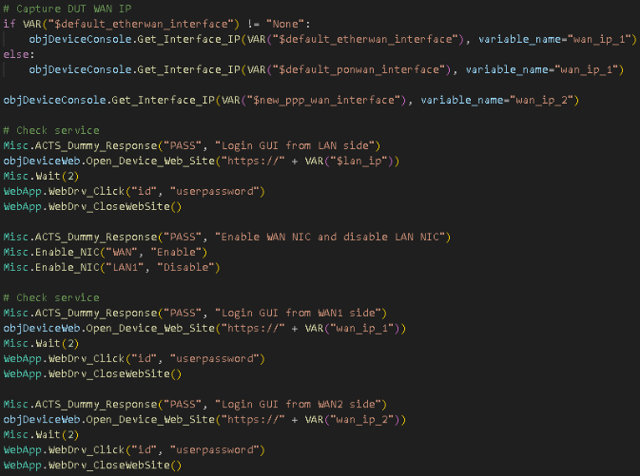
Test Step: Service check

Slide 16
Summary
使用 ACTS_Dummy_Response 將測試步驟 print 在 test report 上
使用 object 的方式編寫 script
objxxx = ModuleName.ClassName(parameter)
使用 object 的方式才會有繼承的概念，否則就只是獨立的個體
Create Web function module: 在 WebGUI 上可以設定的欄位都應該在 module 裡定義為參數

Slide 17
Test Case 2 – NAT : Port Forwarding
Port Forwarding rule by Port, verify WAN traffic will all forward to this host
Create and setup Port Forwarding setting
Service check: using iPerf
Setup LAN_WKS IP to static IP address

Slide 18
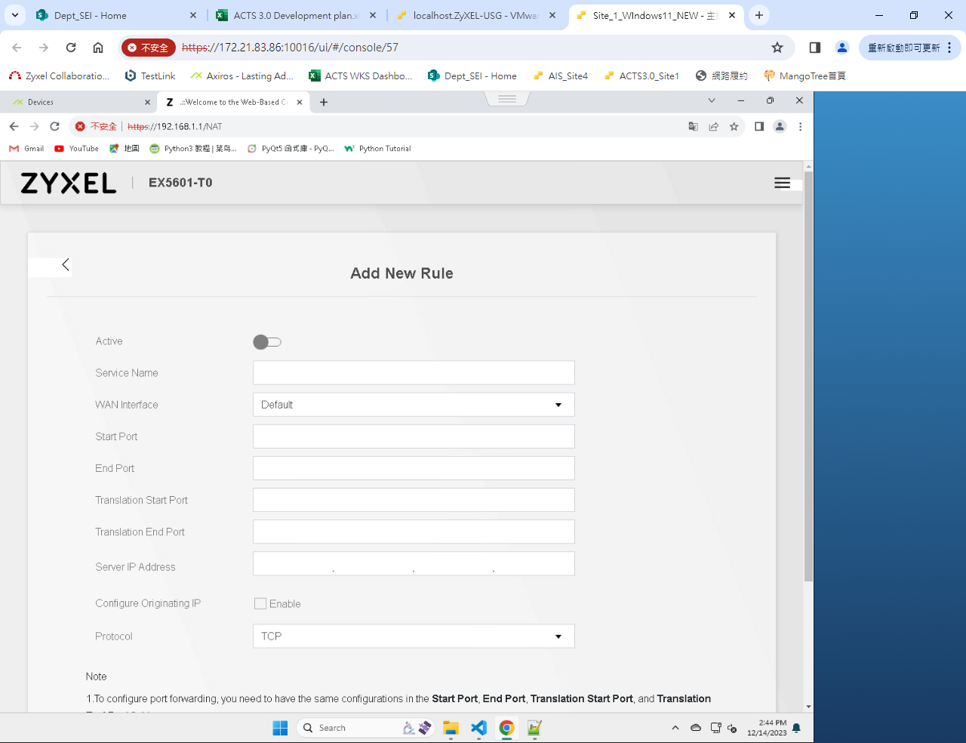
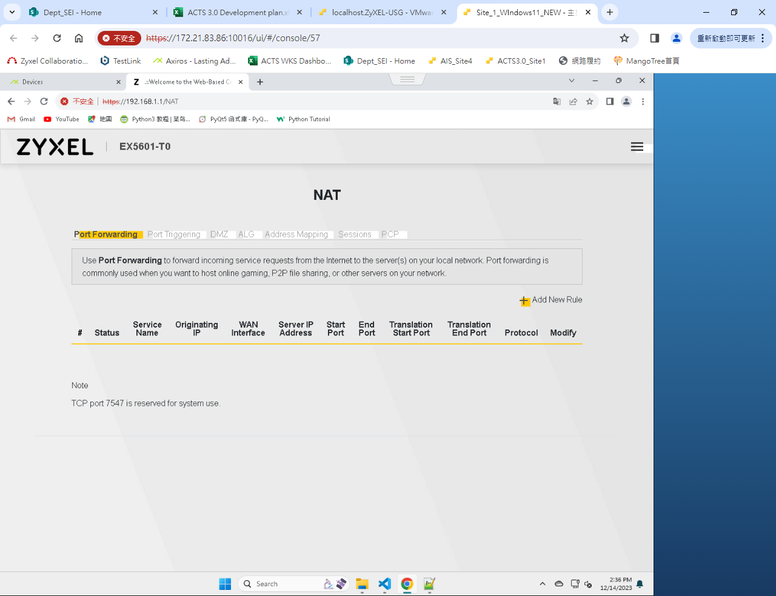
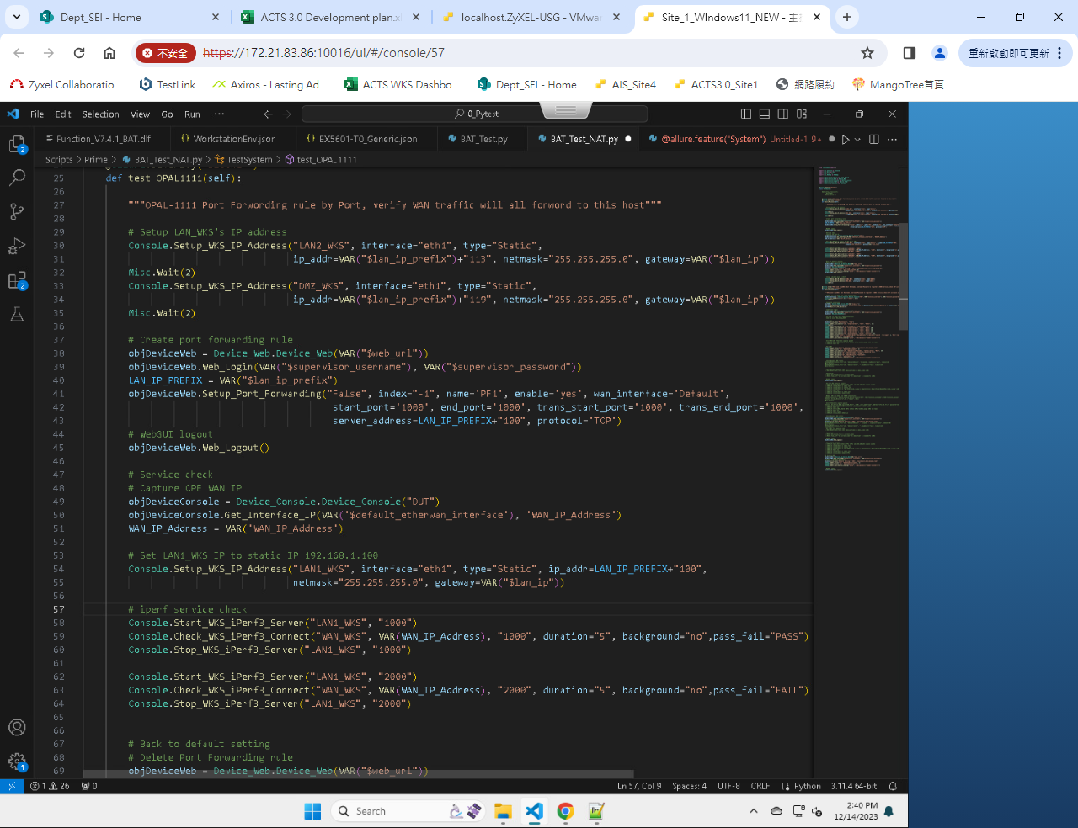
Test Step: Add and setup Port Forwarding setting

Slide 19
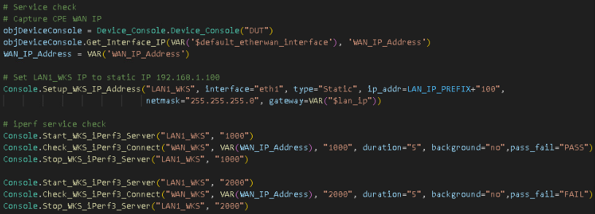
Test Step: Service check

